Slide 1

JSS ACADEMY OF TECHNICAL EDUCATION
DEPARTMENT OF COMPUTER SCIENCE AND ENGINEERING
INTERNSHIP EVALUATION PHASE 2
Software defined network Framework for data broadcasting with machine learning
PRESENTED BY:
CHANDAN M (1JS16CS403)
UNDER THE GUIDANCE OF:
Mr. RENUKA RAJENDRA B
Asst. Professor
Dept. of CSE

Slide 2
Software defined network
Framework for data broadcasting with machine learning

Slide 3
Introduction
SDN is a framework to allow network administrators to automatically and dynamically manage and control a large number of network devices, services, topology, traffic paths, and packet handling (quality of service) policies using high-level languages and APIs. Management includes provisioning, operating, monitoring, optimizing, and managing FCAPS (faults, configuration, accounting, performance, and security) in a multi-tenant environment.

Slide 4
ARCHITECTURE

Slide 5
EXISTING SYSTEM
No proper cluster framing mechanism with proper energies allocation.
Cluster head mechanism with shortest path finding is not there.
Making the cluster head as edge node is applicable
Shortest path with respect aggregated energies threshold is rare.

Slide 6
PROPOSED SYSTEM
Cluster framing with dynamic range of energies allocation with proper central repository control.
Shortest path is 2 ways one is to make source-cluster head(edge)-cluster head(edge other side cluster)-destination.
Edge nodes are always cluster heads.
Based on the threshold shortest path should be made according to the aggregated threshold. So the node which satisfies only will come into shortest path(this is second model)

Slide 7
HARDWARE REQUIREMENT
10GB HDD(min)
128 MB RAM(min)
Pentium P4 Processor 2.8Ghz(min)

Slide 8
SOFTWARE REQUIREMENT
Java1.4 or higher
Java Swing – front end
Networking-Socket programming
Windows 98 or higher-Operating System

Slide 9
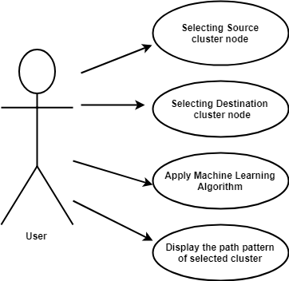
USE CASE DIAGRAM

Slide 10

DATA FLOW DIAGRAM

Slide 11
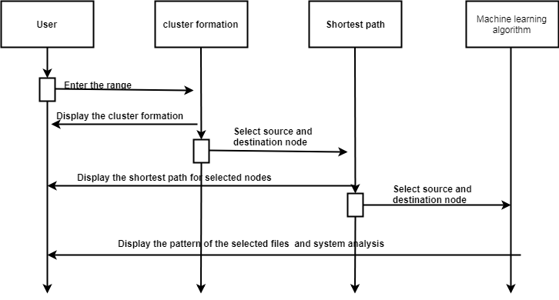
SEQUENCE DIAGRAM

Slide 12
PSEUDO CODE
Random Uniform Matrix Generation
t1=MAKE(C1)
t2=MAKE(C2)
t3=MAKE(C3)
t4=MAKE(C4)
n1⬅RANDOM(1 - 150)
n2⬅RANDOM(1 - 150)
n3⬅RANDOM(1 - 150)
n4⬅RANDOM(1 - 150)
C1=ASSIGN ENERGIES(t1,n1)
C2=ASSIGN ENERGIES(t2,n2)
C3=ASSIGN ENERGIES(t3,n3)
C4=ASSIGN ENERGIES(t4,n4)
Ch1⬅MAXENERGY(C1)
Ch2⬅MAXENERGY(C2)
Ch3⬅MAXENERGY(C3)
Ch4⬅MAXENERGY(C4)
DISPLAYACK(C1,C2,C3,C4)

Slide 13
CONCLUSION
Based on the current existing scenario with the current work the conclusion is to make the edge node as cluster head for sure for broad casting. The proper broadcasting is getting done only with shortest path with which nodes are having more than aggregated threshold value. So to reduce duplicate broadcast this work is updated with machine learning model for updating of past paths.

Slide 14
THANK YOU…..!

